Slide 1

BE
FAITHFUL
Genesis
Dr. Rick Griffith, Crossroads International Church Singapore
CICFamily.com • BibleStudyDownloads.org

Slide 2

A World of Idols
Notes:
In our hostile world full of idols, God says to be faithful to him as you face your future.
Persecution of Christians has been at its height the past century. More believers died in the 20th century than in the previous 19 centuries combined!
The media marginalizes the Christian viewpoint. One Supreme Court decision was thrown out because the Bible was used as evidence!

Slide 3
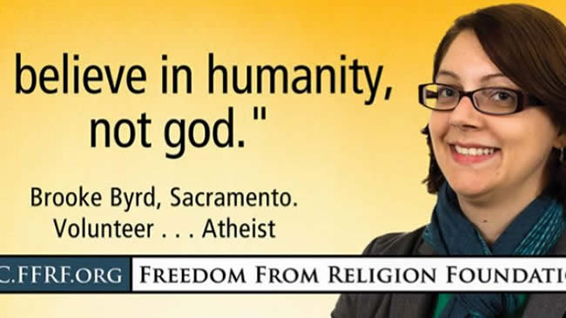
"Believe in humanity, not god."
Notes:
The atheists in particular have become more emboldened to tell us to abandon our faith.

Slide 4


How can you be faithful to God in a world of idols?
IDOLS
of the
HEART
Notes:
“Son of man, these leaders have set up idols in their hearts. They have embraced things that will make them fall into sin. Why should I listen to their requests? ⁴ Tell them, ‘This is what the Sovereign LORD says: The people of Israel have set up idols in their hearts and fallen into sin, and then they go to a prophet asking for a message. So I, the LORD, will give them the kind of answer their great idolatry deserves. ⁵ I will do this to capture the minds and hearts of all my people who have turned from me to worship their detestable idols.’” (Ezekiel 14:3-6 NLT).

Slide 5

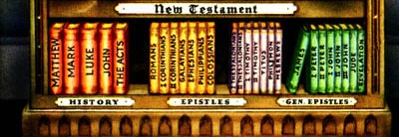
How can you remember all these books?
Notes:
But how well do you know G You can’t be faithful to what you don’t know, so you must grow in the God of the Word and the Word of God.
Like many believers, I lament that we don’t know the Bible as well as past generations. This week only three of my 46 students could even list the books of the OT.
Yet part of the blame is on us Bible teachers—pastors, SS teachers, professors, parents, and other teachers have not systematically taught through Scripture. od’s Word to help defeat the idols of our day?

Slide 6

Let's Study Through Scripture
The Bible: Book by Book
Notes:
This preaching series looks at each book in the Bible in a single sermon—66 messages that each cover an overview of an entire book.
I have taught through the Bible 37 times but never preached through it. Therefore, as I just finished 12 messages on the Minor Prophets, so now I will preach the other 54 books in the coming year until we learn all 66 books.
I encourage you to read through the Bible during this series, one book at a time.

Slide 7
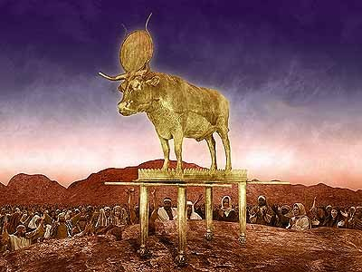
Where was Israel?
Notes:
As we approach Genesis, where was Israel geographically? Where did the first readers receive the book of Genesis? God needed to prepare Israel to be faithful before facing Canaan’s idolatry—thus he had Moses write Genesis in the wilderness before the Conquest to instruct them.

Slide 8
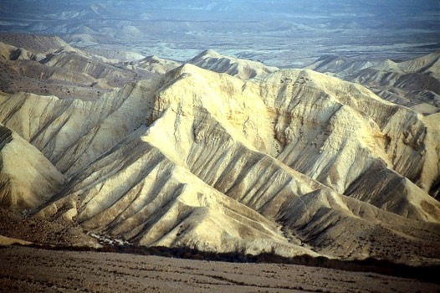
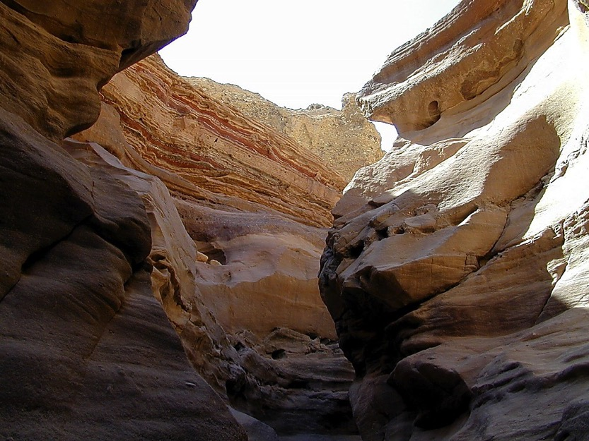
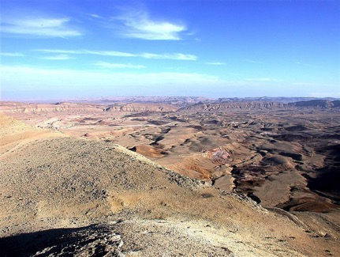
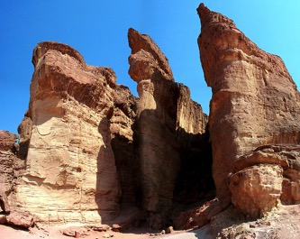
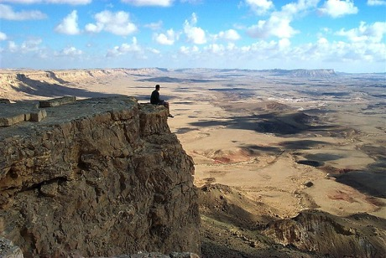
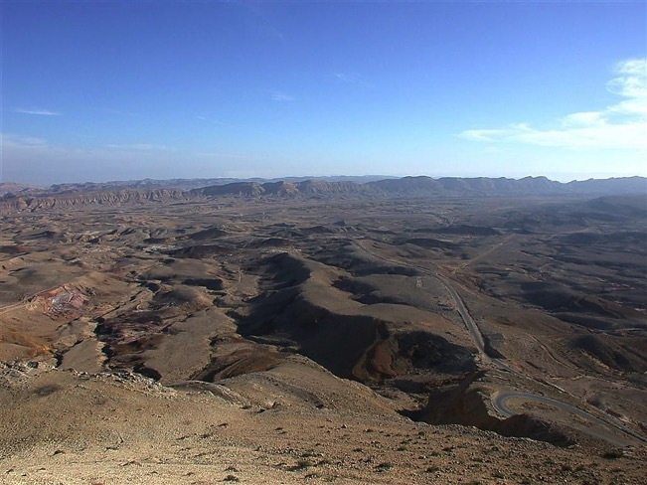
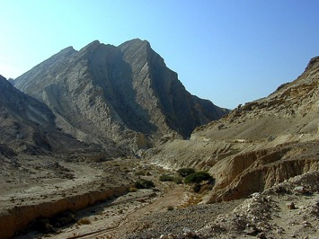
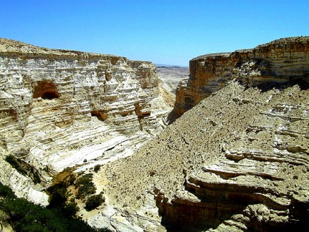
YOU MEAN… 40 YEARS?
OUT HERE?
Num. 32:13
DRESSING
THE
STAGE
YOU MEAN…
40 YEARS?
OUT HERE?
YOU MEAN…
40 YEARS?
OUT HERE?
MOSES
Exodus
Sinai
M - C - C
Kadesh Barnea
40
40
Handbook pg. 26-29
23
Notes:
Israel has just had 400 years in Egypt. We pick up the account where they had gotten out of Egypt, but Egypt hadn’t gotten out of them. They need a fresh look at who they are after generation of slavery in s foreign land.

Slide 9

Jericho
DEAD SEA
JORDAN RIVER
MODERN JERICHO
JOSHUA
Jericho/Ai
ANCIENT JERICHO
From Jericho...
Looking East Across the Jordan River
Handbook pg. 26-29
42
Notes:
God told Moses that he will die in the wilderness—so how could Moses best prepare the nation to enter the land of Canaan?

Slide 10

Israel needed to know, "Who is their God"?
56
Notes:
They need to be taught who God is and how they are a nation chosen by the Sovereign Lord of all creation.
Then they will see that Canaan’s giants and walled cities are puny in comparison to their great God

Slide 11

Genesis
Summary Statement
56
63
41
The narrow lineage of Israel from Creation to Joseph informs Israel it began by God's election for rule and unconditional promise for blessings through Abraham in contrast to the Canaanites
Notes:
So what better way to show their identity but by writing a theological history of where they came from? That’s what we have in the pages of Genesis: The narrow lineage of Israel from Creation to Joseph informs Israel it began by God's election for rule and unconditional promise for blessings through Abraham in contrast to the Canaanites.

Slide 12
Key Word
56
39
Election
Genesis
Notes:
The key word for Genesis is election—God chose them to rule with him and he does the same for us.

Slide 13
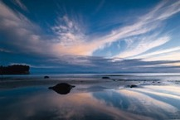
Genesis
56
Origin in Election and Promise
Creation | Fall | Fall | Flood | Flood |  | Babel | Jacob | Abraham |  | Isaac | Jacob | Joseph | Joseph | Isaac
Primeval Events |  |  |  |  |  |  |  | Patriarchal Characters
1:1–11:26 |  |  |  |  |  |  |  | 11:27–50:26
God’s Election |  |  |  |  |  |  |  | God’s Promise
Adam and Descendants |  |  |  |  |  |  |  | Abraham and Descendants
1/5 of the Book |  |  |  |  |  |  |  | 4/5 of the Book
Mesopotamia |  |  |  |  |  |  |  | Canaan |  |  |  | Egypt
2083 Years (4143-2060 BC) |  |  |  |  |  |  |  | 215 Years (2060-1845 BC) |  |  |  | 71 Years (1845-1774 BC)
The tôledôt of… | Heavens & Earth |  | Adam | Noah | Sons of Noah | Sons of Noah | Shem | Terah | Ishmael | Ishmael | Isaac |  | Esau | Jacob
Creation | Post-Creation |  | Sons of Adam | Noah | Sons of Noah | Sons of Noah | Sons of Shem | Abraham & Isaac | Sons of Ishmael | Sons of Ishmael | Jacob |  | Sons of Esau | Joseph
1:1–2:3 | 2:4–4:26 |  | 5:1–6:8 | 6:9–9:29 | 10:1–11:9 | 10:1–11:9 | 11:10-26 | 11:27–25:11 | 25:12-18 | 25:12-18 | 25:19–35:29 |  | 36:1–37:1 | 37:2–50:26
Covers 2369 Years of History
Written During Wilderness Wanderings (c. 1405 BC)
Notes:
Genesis 1–11 shows Israel’s origin in election and pivots in Genesis 12 to show the nation originated in God’s promise to Abraham to bless all peoples.

Slide 14
How can you be faithful to God in a world of idols?
IDOLS
of the
HEART
2 ways
Notes:
Today in Genesis we will see two ways to be faithful to God in a world of idols.
(What is the first way to be faithful to God in a world of idols?)

Slide 15

I. Grasp that the King chose you to rule (Gen 1-11).
Notes:
We must know our amazing identity as God's elect people.

Slide 16

Is Genesis 1–11 Real History?
58
Myths don't teach "deep truths" better than history
A non-historical approach is very subjective
They have vital information otherwise not known
They fit into the book's argument emphasizing election
Events are presented as historical
Science confirms the Genesis 1–11 historical record
Christ affirmed their historicity
Notes:
I believe we have genuine history in the first 11 chapters of the Bible. Why? Seven reasons…

Slide 17
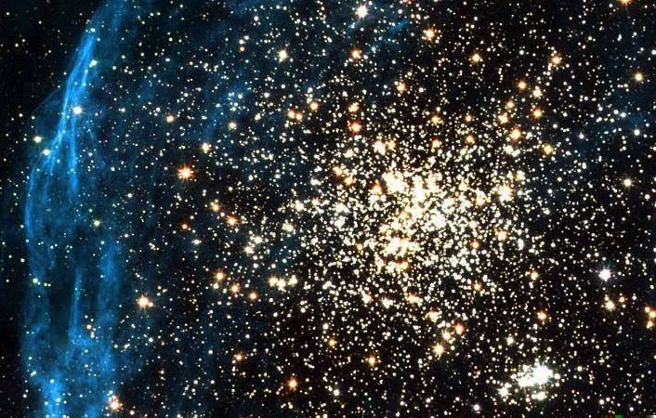
Key Word for Genesis:
56
Election
©2003 TBBMI
7.5.03a.
19
Notes:
But this is also Elect History: God chose people to rule with him that led to Abraham (1:1–11:26).

Slide 18

Support for Election as the Key Theme
Election
59-62
71b
God's sovereignty and desire to share this rule with man (1:26) is totally his choice alone
The eleven-section structure narrows down the chosen seed with which God can fellowship
The overall design shifts from God choosing Adam & his seed (1–11) to Abraham & his seed (12–50)
Repeated election of the younger over the older shows God's choices are superior to man's
Notes:
Election of God’s choice permeates Genesis in at least 4 ways…

Slide 19
God chose the older son to serve the younger!
Election
62
Older serves the | Younger | References
Nahor | Abraham | 11:27-28
Ishmael | Isaac | 21:10-12
Esau | Jacob | 25:29-34; 27:27-29, 38-40
Reuben, etc. (10 older brothers) | Joseph | 37:5-11
Manasseh | Ephraim | 48:13-14, 17-20
Reuben, Simeon, Levi (all 3 are older brothers) | Judah | 49:8-12
©2003 TBBMI
7.5.03a.
20
Notes:
Repeated election of the younger over the older shows God‘s choices are superior to man’s. In fact, nearly every man God chose was NOT the older son…

Slide 20
Slides on
Genesis 1
Notes:
In the first chapter, Creation portrays God as the Creator of all life (except angels and God) to show Israel that the sovereign LORD of the universe elected them for rule—not Canaan’s impotent deities—and to highlight the Sabbath (1:1–2:3).

Slide 21

Days of Creation
33
Void
Formless
Forming
Filling
Day 4: Sun, moon & stars arranged
Day 1: Light
Day 2: Water & air separated
Day 5: Fish & fowl
Day 3: Land & sea separated
Day 6: Animals & man
Genesis 1:3-31
Notes:
There is no accident or evolution of trial-and-error in Genesis 1—God carefully made everything by his choice. As expected, he formed the world for three days before he filled it.

Slide 22


GOD: I just created a
24-hour period of alternating lightness and darkness on earth…
ANGEL:
What are you going to do now?
GOD:
Call it
a day.
Notes:
BE-01-Gen-Be Faithful-22
OP-01-Gen-Be Faithful-22
CR-41-Theistic Evolution-27
OB-41-Theistic Evolution-27
OS-01-Gen1-3-Slide 132

Slide 23

When did death come into the world?
Notes:
Here is one of the most vital questions you can ask.

Slide 24
Slides on
Genesis 2
Notes:
Do you see any sign of death in Genesis 1 or Genesis 2? Neither do I—because you cannot find it there.

Slide 25

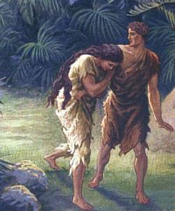
Did death exist before sin?
What do you think?
VERY GOOD
What does it mean that creation was "very good" if death existed then?
Notes:
So did death exist before sin? What do you think? God said that his creation up to this time was "very good." What does it mean that creation was "very good" if death existed then?

Slide 26
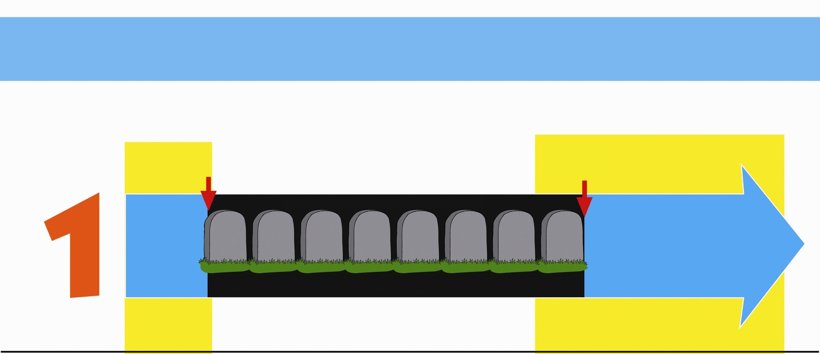
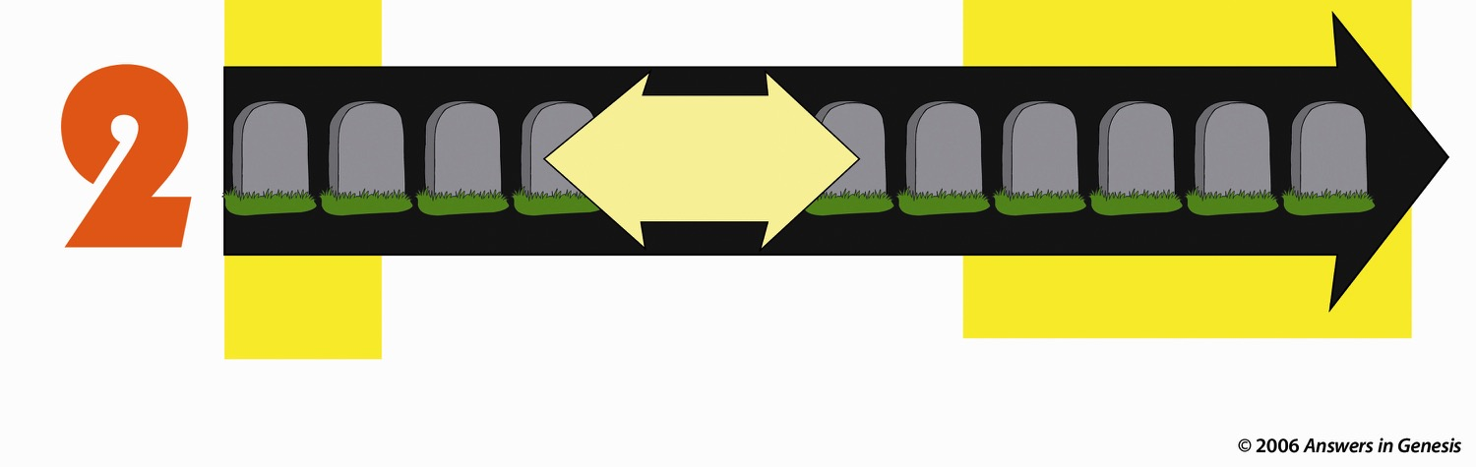
Two Histories of Death
How long has death existed (Rom. 5:12)?
Beginning
Death is an enemy
Future
Man's sin brought Death
DEATH will be done away with
ONLY THOUSANDS OF YEARS
God's Word
NO DEATH
NO DEATH
Death is temporary
Man's Opinion
MILLIONS AND MILLIONS OF YEARS
Life and death have always been together
Death is a permanent part of history
As long as there is life, there will be death
Notes:
Only two options exist, either
God’s Word that teaches no death in the creation and therefore no death in the future, or…
Man’s opinion that death has always existed and always will exist.

Slide 27

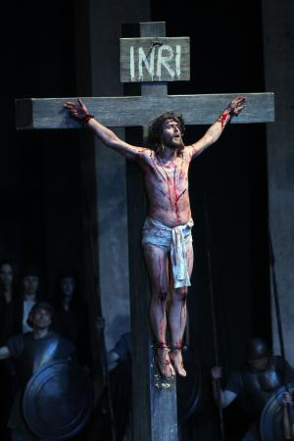
Genesis 3
What we
did wrong
What God did right
Notes:
Genesis 3 tells what went wrong and how our problem is met with God's solution.

Slide 28
Slides on
Genesis 4
Notes:
Events after the creation of the heavens and the earth reveals that Adam’s creation, fall, and sinful expansion deteriorate the race and show the need for a Redeemer (2:4–4:26).

Slide 29
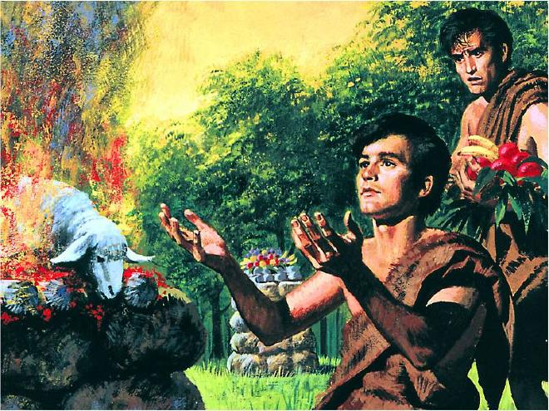
"By Faith…" (Hebrews 11)
"It was by faith that Abel brought a more acceptable offering to God than Cain did. Abel's offering gave evidence that he was a righteous man, and God showed his approval of his gifts. Although Abel is long dead, he still speaks to us by his example of faith" (Heb. 11:4 NLT)
Notes:
Things got so bad that Cain even killed his own brother Abel.

Slide 30
Slides on
Genesis 5
Notes:
The key idea of Genesis 5 is not genealogies as much as death reigning on the earth.

Slide 31

Genesis 5 Genealogy
85
Adam
Seth
Enosh
Kenan
Mahalalel
Jared
Enoch
Methuselah
Lamech
Noah
Notes:
Ten generations of long lives still include death.

Slide 32
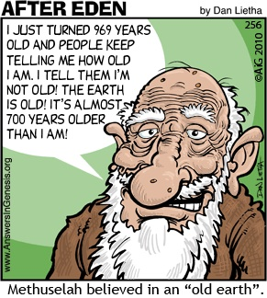
Methuselah
90
I JUST TURNED 969 YEARS OLD AND PEOPLE KEEP TELLING ME HOW OLD I AM. I TELL THEM I'M NOT OLD! THE
EARTH IS OLD! IT'S ALMOST 700 YEARS OLDER THAN
I AM!
Methuselah believed in an "Old Earth."
Notes:
How old is the earth? Let’s ask the oldest man!

Slide 33
Slides on
Genesis 6
Notes:
Adam’s descendants resulting in demon-possessed rulers who took harems show how sin results in death so that God needs to start over with a righteous man, Noah (5:1–6:8).

Slide 34


Fossils on Garden of Eden
GARDEN OF EDEN
PAIN
FOSSIL
RECORD
DEATH
Noah's
Flood
KILLING
DISEASE
STRUGGLE
SUFFERING
EXTINCTION
Notes:
The Bible says that it all started good, but the fossil record shows horrible things that came out of the Flood.

Slide 35
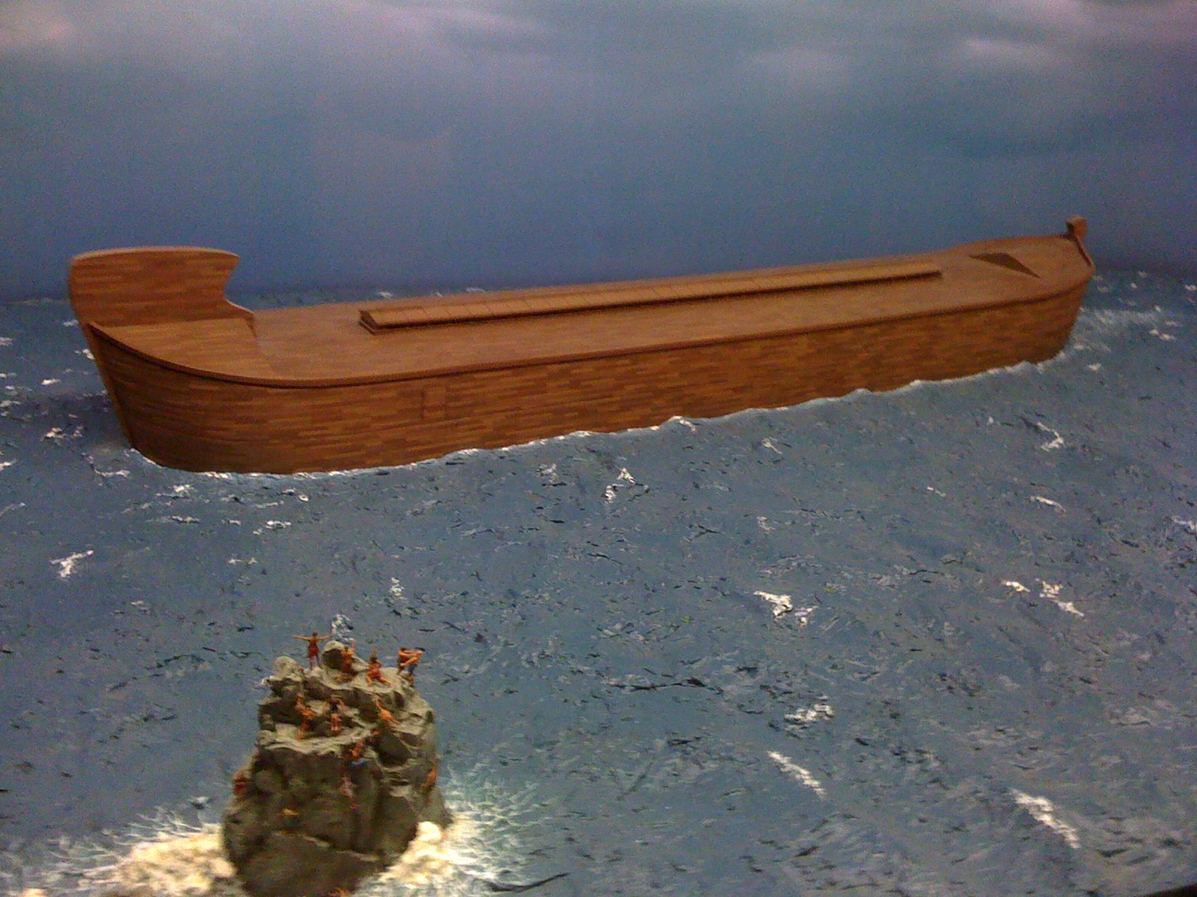
The Ark
Notes:
Noah’s descendants led to his grandson Canaan after the Flood to affirm both God's righteous judgment due to man's sin and his gracious redemption in electing people with whom he can fellowship (6:9–9:29).

Slide 36
Slides on
Genesis 7
Notes:
Genesis 7 shows how much of the earth was covered in water.

Slide 37
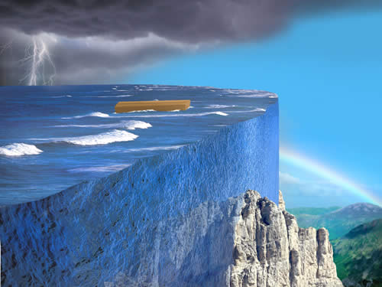
How high was the water?
77j
"The waters rose and increased greatly on the earth, and the ark floated on the surface of the water. ¹⁹ They rose greatly on the earth, and all the high mountains under the entire heavens were covered. ²⁰ The waters rose and covered the mountains to a depth of more than twenty feet" (Gen. 7:18-20).
Notes:
If the water covered even the highest mountains, then it obviously did not look like this in a local flood! No—it covered everything just as the Bible says.

Slide 38
Slides on
Genesis 8
Notes:
Genesis 8 shows 8 in the ark.

Slide 39
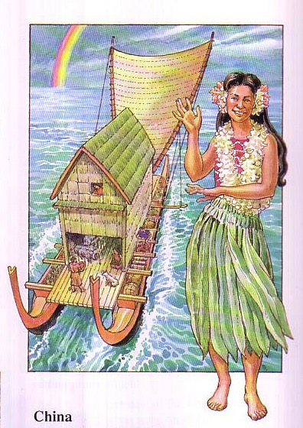
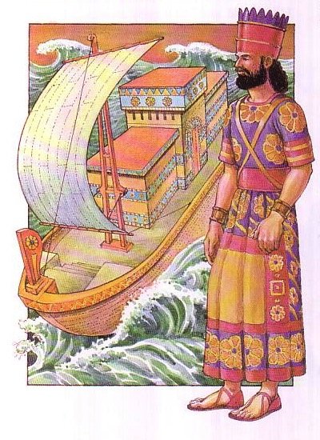
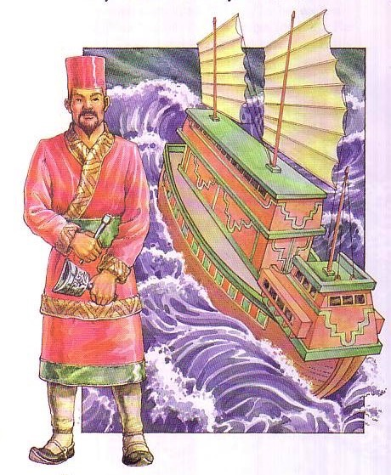
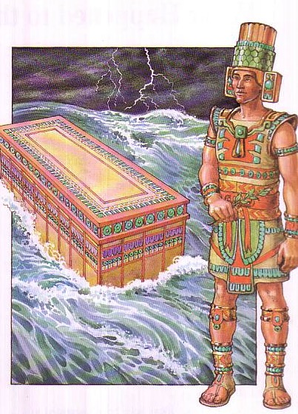
Flood Legends
83c
270 Flood Legends
Hawaii
Babylonia
Mexico
Common Elements:
universal flood
boat saved
family passengers
China
Notes:
We should expect many societies to have universal Flood stories—and that is exactly what we find. Though they are tweaked somewhat, they have three common traits.

Slide 40
Slides on
Genesis 9
Notes:
But, again, this section shows that Noah’s descendants led to his grandson Canaan after the Flood to affirm both God's righteous judgment due to man's sin and his gracious redemption in electing people with whom he can fellowship (6:9–9:29).

Slide 41
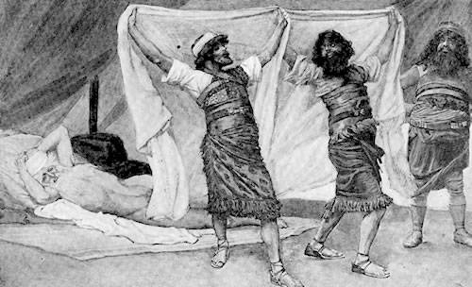
Noah Wasn't Perfect
"Ham, the father of Canaan, saw that his father was naked and went outside and told his brothers. ²³Then Shem and Japheth took a robe, held it over their shoulders, and backed into the tent to cover their father. As they did this, they looked the other way so they would not see him naked" (9:22-23 NLT).
Notes:
Noah was righteous but not perfect, of even Noah needed God.

Slide 42
Slides on
Genesis 10
Notes:
Noah’s son’s descendants traced to the tower of Babel judgment favor Shem in the line of blessing among earth’s many nations and languages (10:1–11:9).

Slide 43

The Table of Nations
92
NOAH
Sino
Japheth
HAM
SHEM
Sin
Caucasians
Canaanites
Semites
Sinai
Europeans &
East Indians
Africans &
Asians
Jews &
Arabs
Genesis 10
Notes:
Noah’s three sons became three divisions of humanity in three major areas.
Asians stem from Canaanites in the city of Sin—not those who migrated south to the Sinai but those who migrated east to Chino. Here is why we have these terms of Sinai and East Asians called Sino.

Slide 44
Slides on
Genesis 11
Notes:
In chapter 11, Shem’s descendants traced to Abram show divine election in the narrowing line of blessing to Abraham to prepare for the following patriarchal history that restores blessing from chaos and dispersion (11:10-26).

Slide 45

4-11 Hello World 02280
Notes:
45
Why do we have so many ways that we greet people today?

Slide 46
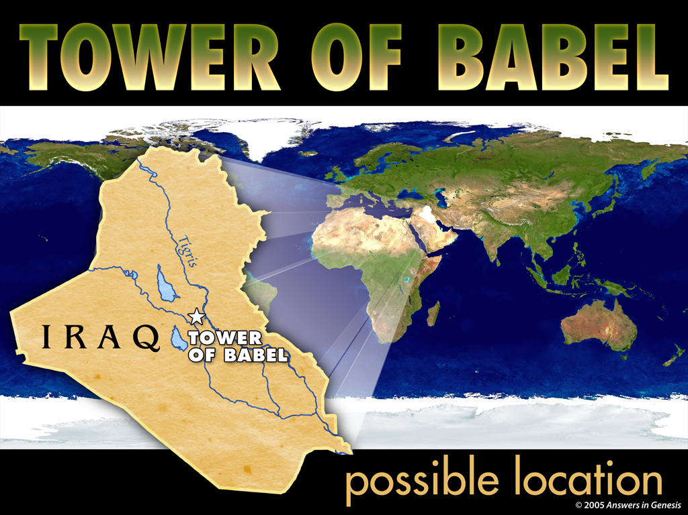
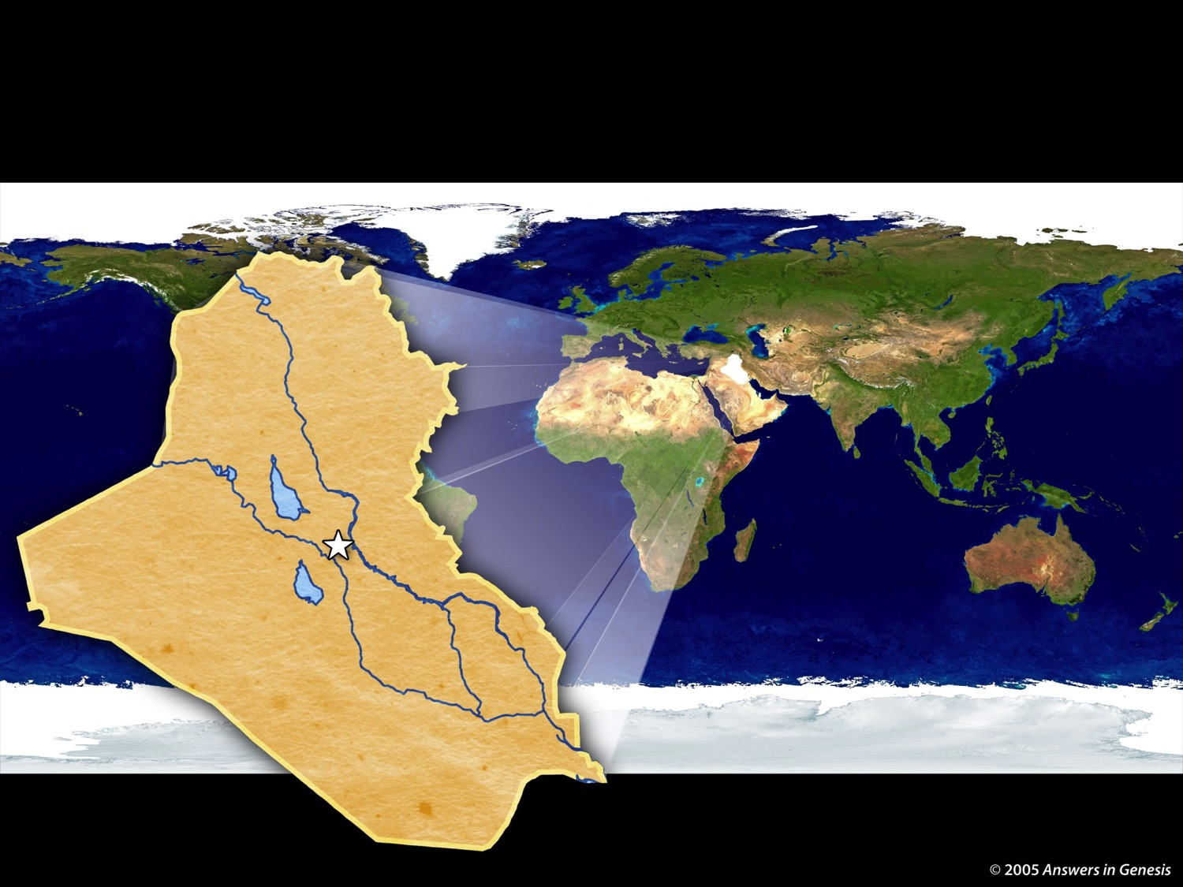
4-07 Tower of Babel Map 02277
TOWER OF BABEL
IRAQ
Tower
of Babel
possible location
Notes:
46
46
Our confusion of languages stems from the city of Babylon where people proudly sought to reach God by their own efforts. God judged them by giving them different languages.

Slide 47
Cycles in Genesis 1–11
Created
to Rule
1:1–2:3
New Start
8:20–9:17
New Start
11:10-26
World
Failure
6:1–8:19
Family
Failure
2:4–4:26
World
Failure
11:1-9
Family
Failure
9:18-29
=
Seed of Adam
5
Seed of Noah
10
Seed of Terah
11:10-26
The Line of Blessing
Adapted from Mann, Genesis, 13
Notes:
Genesis 1–11 records two cycles of God overcoming man’s failure. Through it all, God faithfully chose The Line of Blessing from Adam to Noah and eventually to Terah and his descendent, Abraham.

Slide 48
The Kingdom of God:
The Bible's All-Encompassing Theme
445
Genesis 1:26-28
"Then God said, 'Let us make man in our image, in our likeness, and let them rule over the fish … birds … livestock … all the earth, and over all the creatures that move along the ground…' God blessed them and said to them, 'Be fruitful and increase in number; fill the earth and subdue it. Rule over the fish of the sea and the birds of the air and over every living creature that moves on the ground.'"
Revelation 22:5
"There will be no more night. They will not need the light of a lamp or the light of the sun, for the Lord God will give them light. And they will reign for ever and ever."
The Bible's Theme: God extends His rule to man
Command
Covenants
Fulfillment
Notes:
God chose believers like us to rule the world!
Throughout Scripture we see the Kingdom of God as the primary theme from the first to the last chapter. But we also see God establishing covenants, or promises, alongside his kingdom rule to enable us to see our eventual rule with him accomplished.

Slide 49
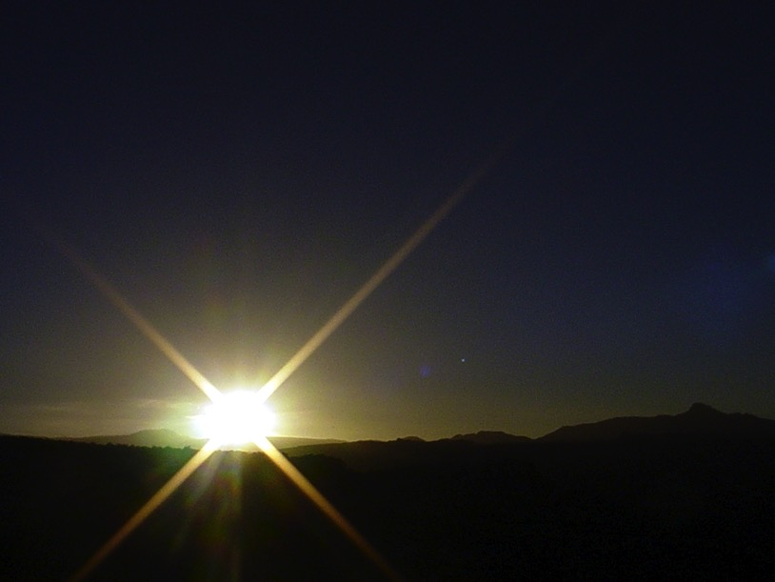


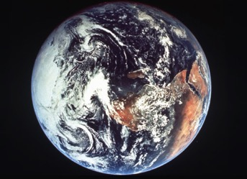
The Bible's Chiasm
446
Repeated Patterns in Reverse Order
Christ's Redemption
Christ's Rule
Man's Rule Lost at
Fall
Man's
Rule Restored at Millennium
Creation
New Creation
Notes:
We need to know who we are—more accurately, who God says we are—our future identity.
Creation in Genesis 1–2 is repeated In the Restored, New Creation in Rev 21–22
Man was created to rule over the fish, birds, and land animals (Gen. 1:28) but he gave over his rule over to the god of this world, Satan (2 Cor. 4:4)
However, this rule is restored during the 1000-year reign of the saints (Rev. 20:4-6)
But Christ is the central Person of history: both as Lamb (Redeemer) and as Lion (Ruler of all creation in the line of David)

Slide 50
A Glimpse at the Future
437
Rapture
2nd Advent
(Zech 14:3-5)
Great
White
Throne
(Rev. 20:11-14)
Church Age
Tribulation
(Zech 14:1-2)
Millennium
(Zech. 14:6-21)
Gog & Magog
(Armageddon)
(Ezek. 38–39)
Gog and Magog
Revisited
(Rev. 20:7-10)
Notes:
50
God’s choice of us to rule also means that we also need to know what God has promised us.
What is ahead from our present Church Age is the return of Jesus in two stages with a seven-year Tribulation on either side. After Armageddon, the Second Advent (Coming) will bring in 1000 years of world peace until another Gog and Magog battle prior to the Great White Throne judgment of God.

Slide 51
How can you be faithful to God in a world of idols?
IDOLS
of the
HEART
2 ways
Notes:
Today in Genesis we will see two ways to be faithful to God in a world of idols.
(What is the first way to be faithful to God in a world of idols?)

Slide 52
I. Grasp that the King chose you to rule (Gen 1-11).
Notes:
We must know our amazing identity as God's elect people.
(What is the second way to be faithful to God in a world of idols?)

Slide 53

II. Grasp that the King promised you blessings
(Gen 12–50).
Notes:
We must know our amazing identity as God's elect people.

Slide 54
Key Verse
56
"I will bless you… and all peoples on earth will be blessed through you"
(Genesis 12:1-3)
Genesis
Notes:
God promised Abraham that he would make a great nation from him that we know as Israel but that his blessing would go so far that every people would be blessed from Abraham!

Slide 55

Genesis Kingdom Statement
39
God created a perfect kingdom (1–2), but man gave up his rule to Satan (3), so God elected a seed to produce a ruler (4–11) to bless all nations in Abraham (12–50).
Notes:
The LORD is not the one at fault for OUR failure. To the contrary. He has chosen the way for us to regain the rule lost in Eden—and that is by electing the Descendent of Abraham, Jesus, who will bless every people group through Israel.

Slide 56
The Line of Blessing
Adam
3:15
Seth
4:25-26
Noah
Shem
9:18
Terah
= Population
Increase
Abraham
12:1-3
Isaac
Jacob
Joseph
All Nations
Notes:
The population of the earth increased dramatically, but each time resulted in only more wicked people on the earth—people whom God had to judge for their sin. Yet God graciously chose a remnant of godly people as the world again became filled with godless people.

Slide 57
Genesis
56
Origin in Election and Promise
Creation | Fall | Fall | Flood | Flood |  | Babel | Jacob | Abraham |  | Isaac | Jacob | Joseph | Joseph | Isaac
Primeval Events |  |  |  |  |  |  |  | Patriarchal Characters
1:1–11:26 |  |  |  |  |  |  |  | 11:27–50:26
God’s Election |  |  |  |  |  |  |  | God’s Promise
Adam and Descendants |  |  |  |  |  |  |  | Abraham and Descendants
1/5 of the Book |  |  |  |  |  |  |  | 4/5 of the Book
Mesopotamia |  |  |  |  |  |  |  | Canaan |  |  |  | Egypt
2083 Years (4143-2060 BC) |  |  |  |  |  |  |  | 215 Years (2060-1845 BC) |  |  |  | 71 Years (1845-1774 BC)
The tôledôt of… | Heavens & Earth |  | Adam | Noah | Sons of Noah | Sons of Noah | Shem | Terah | Ishmael | Ishmael | Isaac |  | Esau | Jacob
Creation | Post-Creation |  | Sons of Adam | Noah | Sons of Noah | Sons of Noah | Sons of Shem | Abraham & Isaac | Sons of Ishmael | Sons of Ishmael | Jacob |  | Sons of Esau | Joseph
1:1–2:3 | 2:4–4:26 |  | 5:1–6:8 | 6:9–9:29 | 10:1–11:9 | 10:1–11:9 | 11:10-26 | 11:27–25:11 | 25:12-18 | 25:12-18 | 25:19–35:29 |  | 36:1–37:1 | 37:2–50:26
Covers 2369 Years of History
Written During Wilderness Wanderings (c. 1405 BC)
Notes:
Genesis 1–11 shows Israel’s origin in election and pivots in Genesis 12 to show the nation originated in God’s promise to Abraham to bless all peoples.

Slide 58
Slides on
Genesis 12
Notes:
Chapter 12 is the great pivot in the book from God ministering to all people to God choosing one nation to bless all people.

Slide 59
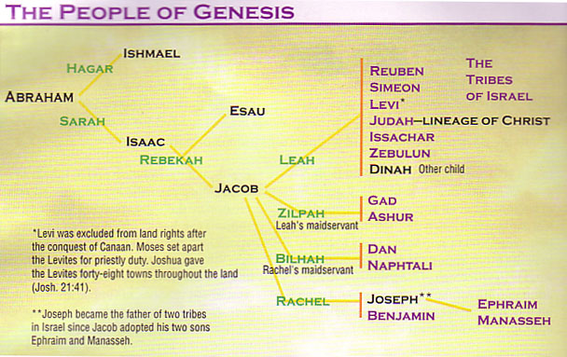
Patriarchal Family Tree
(Gen. 12–50; 1 Chron. 1:28-34)
91
Notes:
Terah’s descendants trace from Abraham to Isaac to Jacob to Joseph and pass on God's covenant promising Abram a land, nation, and blessed name to show Israel its origin as a nation of promise (11:27–50:26).

Slide 60


Abraham
Abraham
Heroes of the Faith
Notes:
An introduction to Abram gives his genealogy to understand his life (11:27-32).
Then…
God makes an unconditional covenant with Abram that promises him a land, a nation, and a blessed name, to reveal to Israel God's initiation, separation, and ratification of His covenant (Gen 12–15).
———
NOTE TO TRANSLATORS: Drag the picture and text at the right over the image above.

Slide 61
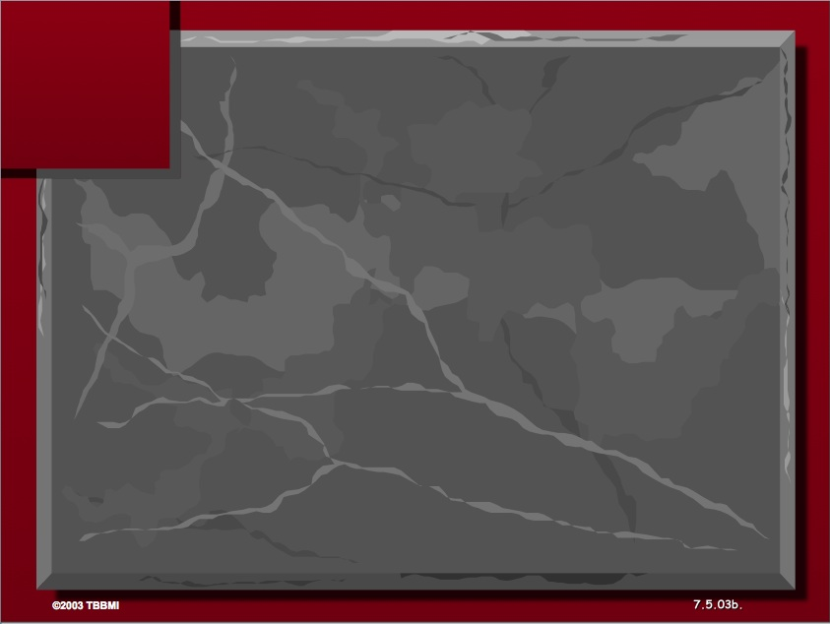
The Three Basic Elements
7
Genesis 12
The Lord had said to Abram,
"Leave your country, your people and your father's household, and go to the land I will show you.
1
A LAND
A SEED
"I will make you into a great nation
and I will bless you;
I will make your name great,
and you will be a blessing.
2
ABRAHAM
The CALL
I will bless those who bless you,
and whoever curses you I will curse;
and all peoples on earth
will be blessed through you."
L - S - B
3
A BLESSING
Handbook pg. 19-24
14
2
Notes:
God appeared to Abram with a threefold promise:
God told this nomad who grew up in the city of Ur that he would provide for him and his descendants a land to live,
God promised this 75-year-old man with a barren wife of decades that he would father an entire nation to come from that barren wife Sarah, and
God assured that the nation that came from him would bless all peoples—especially fulfilled through Jesus, who came 2000 years later to die for the whole world.

Slide 62

The Land of Abraham
93
Genesis 12–24
Haran
Tigris
Euphrates
Canaan
Ur
Egypt
Abraham used to worship the god Sin. After his call he migrated west to obey God but he didn't know where he was going!
Notes:
Abraham knew that it was a sin to worship Sin, so he migrated westward in obedience to God’s command. Genesis 15:6 says that he believed God, and God credited righteousness to him for his simple trust in God.

Slide 63
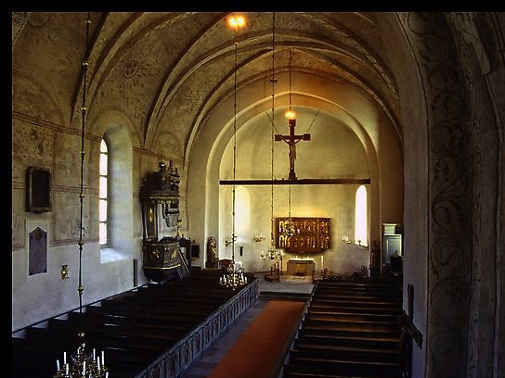
Types of Unconditional Covenants
60
Abrahamic
Land
Davidic
New
Land | Seed | Blessing
Physical | Political | Spiritual
Deut. 30 | 2 Sam. 7 | Jer. 31
Notes:
The three key provisions of the Genesis 12:1-3 Abrahamic Covenant are later amplified in three other covenants in the OT. All will be fulfilled when Christ returns to reign on this earth:
Israel will finally live in the land that God gave as an eternal possession (Genesis 17:8),
Messiah’s rule will finally provide the world with righteous leadership (Isaiah 11),
The blessing to Israel will include many Gentiles among them (Ezek 47-48).

Slide 64
Slides on
Genesis 16
Notes:
God provides Isaac, the promised seed, for Abraham and Sarah, whose faith is developed by testing, that Israel might see how God fulfills His promises (16:1–22:19).

Slide 65
Patriarchal Family Tree
Patriarchal Family Tree
91
Terah
Haran
Nahor
Abraham
Lot
Bethuel
(of Hagar) Ishmael
(of Sarah) Isaac
A Carnal Plan (Genesis 16)
Notes:
Abram’s seeking to secure God's promise of children through a carnal plan that complicates his life is recorded to encourage Israel not to try to accomplish God's will through plans contrary to His will (Gen 16).
——————
Though a man of great faith, Abraham did not have a perfect faith. He wavered and followed Sarah’s advice to bear Ishmael from the slave woman, Hagar. Only 14 years later did he trust God to bring forth Isaac.

Slide 66
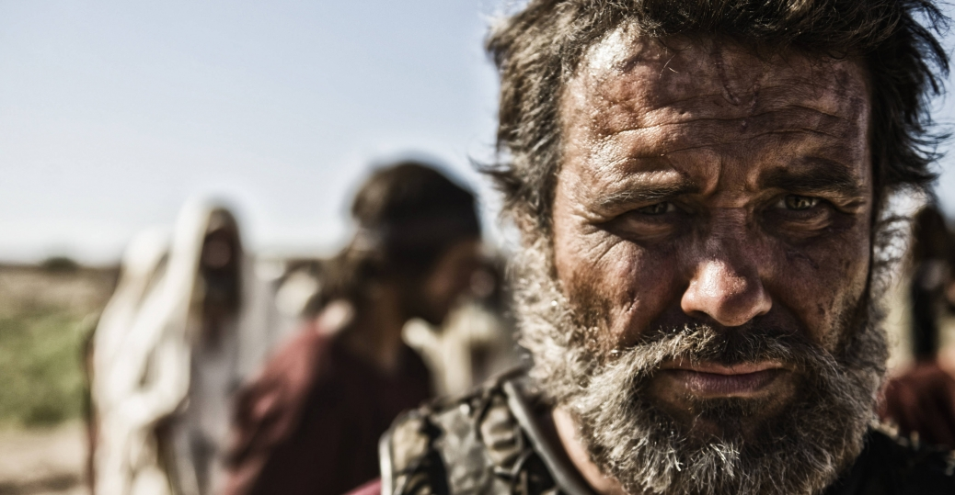
No Son of the Promise
Notes:
Ishmael was clearly not the son through whom the promises would come.

Slide 67

Sarah & Hagar
Notes:
Disunity and even hatred resulted from Sarah’s carnal plan.

Slide 68

Abraham & Hagar
Notes:
God cared for Hagar, as did Abraham, since Ishmael was his son.

Slide 69
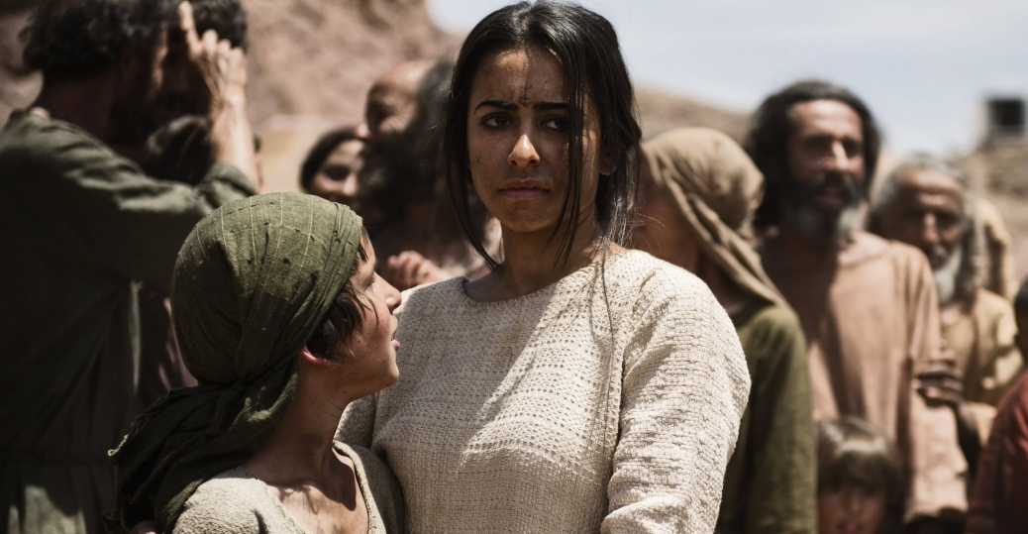
Ishmael & Hagar
Notes:
But the mother and son were banished from Abraham so as not to inherit any of the blessing God intended for Isaac.

Slide 70
Slides on
Genesis 18
Notes:
Genesis 18 shifts the plot to another threat to the promise—this time from another relative, the nephew of Abraham called Lot. When they separated due to their flocks being too large for both of them, Lot chose the fertile Jordan plain, which continued to place Abraham in the land of God’s choice.

Slide 71
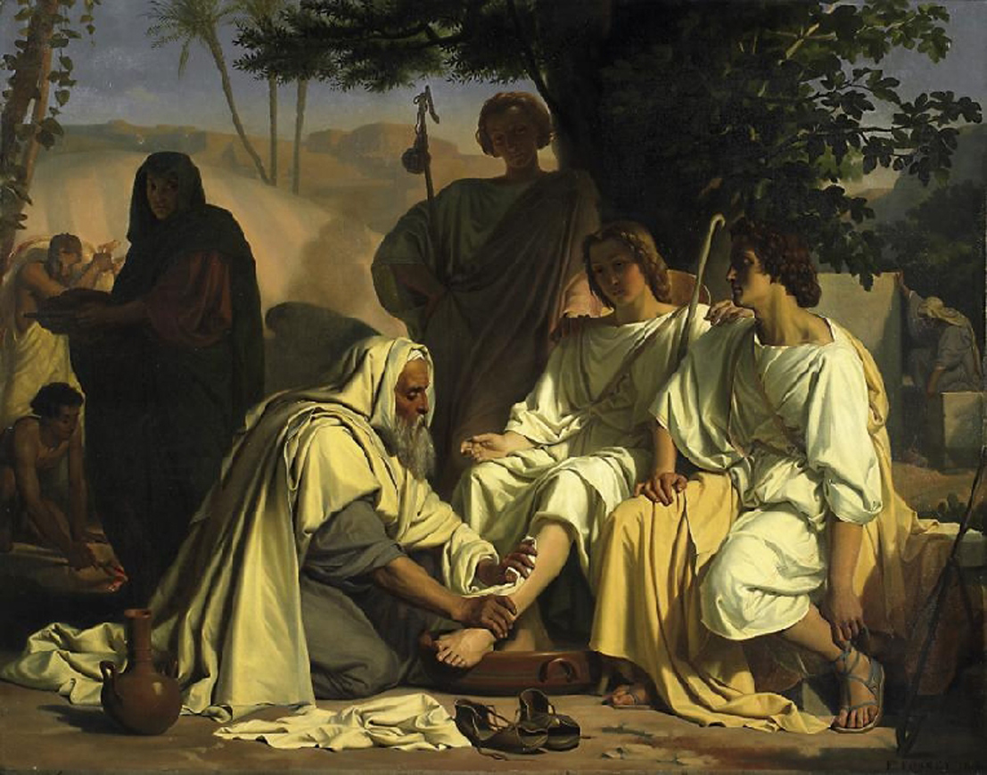
Abraham & Three Guests (Genesis 18)
Notes:
But righteous Lot living in Sodom was not able to influence the city for good—so God determined to destroy Sodom for its idolatry and immorality, including homosexuality. The Lord came with two angels to warn Abraham of Sodom’s destruction, causing him to question if Lot would also be destroyed.

Slide 72
Slides on
Genesis 19
Notes:
An interlude in the testing of Abraham and Sarah records the rescue of Lot and his daughters as examples of God’s mercy on those who live by faith (Gen 19).
___
God assured Abraham that he would not destroy the righteous Lot with the despicable Sodomites.

Slide 73
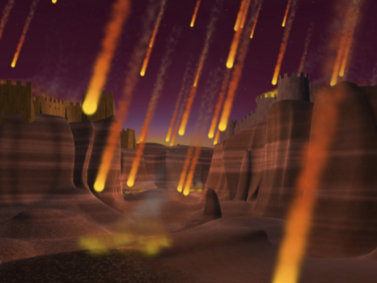
The Destruction of Sodom
Notes:
The Lord mercifully got Lot out with his wife and two daughters before God destroyed the city.

Slide 74
Slides on
Genesis 20
Notes:
Genesis 20 is another threat to the promise.

Slide 75
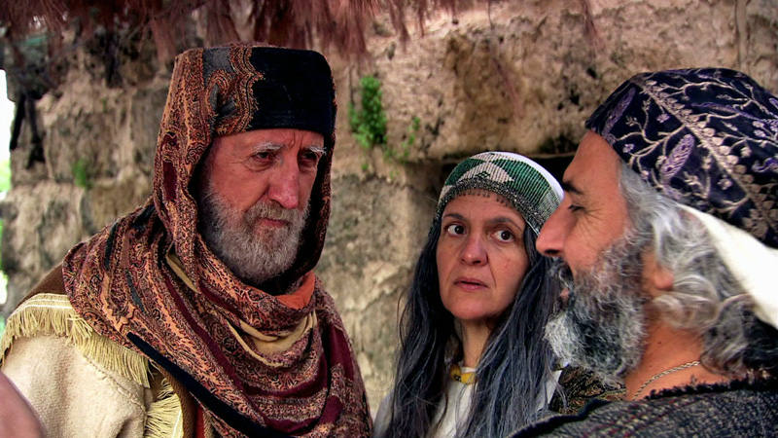
Abimelech, Sarah & Abraham
Notes:
Abraham deceives Abimelech about Sarah but God mercifully protects his promise again to teach Israel that participation in His blessings requires separation from the world—especially from adultery and intermarrying pagans (Gen 20).

Slide 76
Slides on
Genesis 29
Notes:
Let’s jump to Genesis 29. Here God blesses and protects Jacob while in Haran totally by grace yet also disciplines him for marital mistakes and self-sufficiency to teach Israel faith instead of self-effort (Gen 29–32).

Slide 77

(Genesis 29:31–30:24)
Warning: This Section (sex-shun?) is Rated R
Adapted from David Turner • bibleguy.org (used with permission)
Notes:
This popular American TV series focuses on the antics of four desperate women.

Slide 78


Jacob's
Genesis 29:31–30:24
Notes:
There were four of them too!

Slide 79
Slides on
Genesis 34
Notes:
Jacob returns to Canaan and the promised seed is endangered in the land but protected by the hand of God to remind Israel that God keeps His promises (Gen 33–35)

Slide 80

Dinah Violated at Shechem
Brothers Revenge
Genesis 33:18–34:31
Notes:
Jacob’s sons avert marrying the women at Shechem but threaten the promise to Abraham’s descendants by tempting the people of the land to wipe them out for slaughtering the men of Shechem.

Slide 81

Dinah Violated at Shechem
We don't talk about that in church
Genesis 34
Notes:
We typically don’t talk about rape and murder in church—but the Bible gives a very real view of these flawed people through whom God worked—just like us!

Slide 82
Slides on
Genesis 37
Notes:
Jacob’s descendants focus on the life of Joseph, whose bondage and deliverance in Egypt picture the same for Israel and Jesus to teach faith in God’s redemption despite suffering (37:2–50:26).

Slide 83
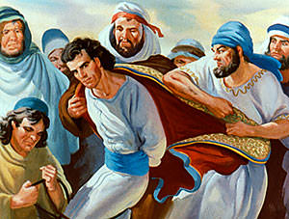
Joseph a Type of Christ
97b
Notes:
Joseph's corrupt family in its envy and intermarriage highlights the unconditional nature of the Promise in God's preserving the chosen line through the older serving the younger despite Israel's sin (37:2–38:30).
————————
"Joseph—a Type of Christ
"By faith Joseph, when he died, made mention of the departing of the children of Israel; and gave commandment concerning His bones." Hebrews 11:22
Jacob had twelve sons. Joseph was his eleventh son, born to Jacob in his old age. Jacob loved Joseph more than all his children. This caused the older brothers to hate Joseph.
Once, when the older brothers were far away tending sheep, Jacob sent Joseph to see how they were. When the brothers saw Joseph coming, they conspired to kill him. One brother, Judah, did not want Joseph to be killed. He persuaded the others to sell him as a slave to a caravan of traders going to Egypt. The brothers told their father that wild beasts had killed Joseph.
Through no fault of his own, Joseph ended up as a slave in the house of Potiphar, a wealthy Egyptian man. But God was with Joseph."
_________
Lesson 9: Jesus Christ is "Lord of All"
http://ubdavid.org/youth-world/winners1/winners1_09.html
Accessed 5 Feb 2016

Slide 84
From Palace to Prison
Genesis 39–41
Notes:
Joseph's testing and exaltation in Egypt show God's work to protect the chosen seed but Israel's need to be faithful as well, despite suffering (Gen 39–41).

Slide 85
Slides on
Genesis 42
Notes:
The deliverance of Jacob's family by Joseph's exaltation in Egypt shows God's protection and blessing on the promised seed, eventually fulfilled in Christ (Gen 42–50).

Slide 86
Deliverance via Joseph's Exaltation
Genesis 42–50

Slide 87
Slides on
Genesis 45
Notes:
Jacob's family moves to Egypt after Joseph tests them and reveals himself so that the family would move there in faith and be provided for through Joseph's wise rule to instruct Israel on God's commitment to his promise (42:1–47:27).

Slide 88
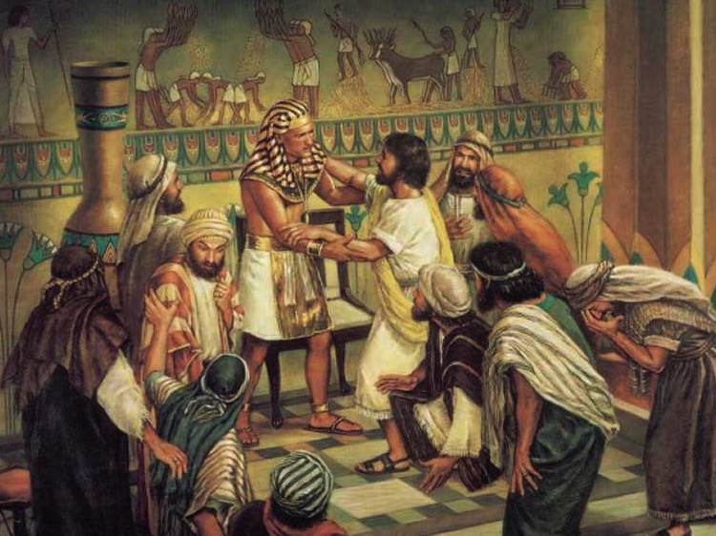
"I am Joseph!
Is my father still alive?"
(Gen. 45:3)

Slide 89
Slides on
Genesis 49
Notes:
God continues to bless Israel through the faithful actions of Jacob and Joseph to encourage Israel to also express faith in God's promise (47:28–50:26).

Slide 90
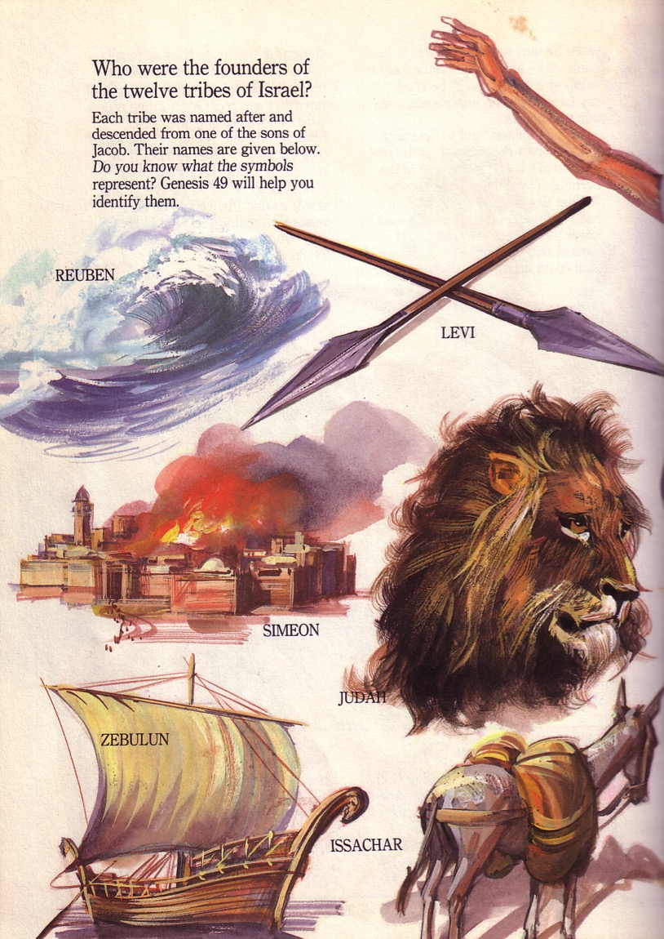
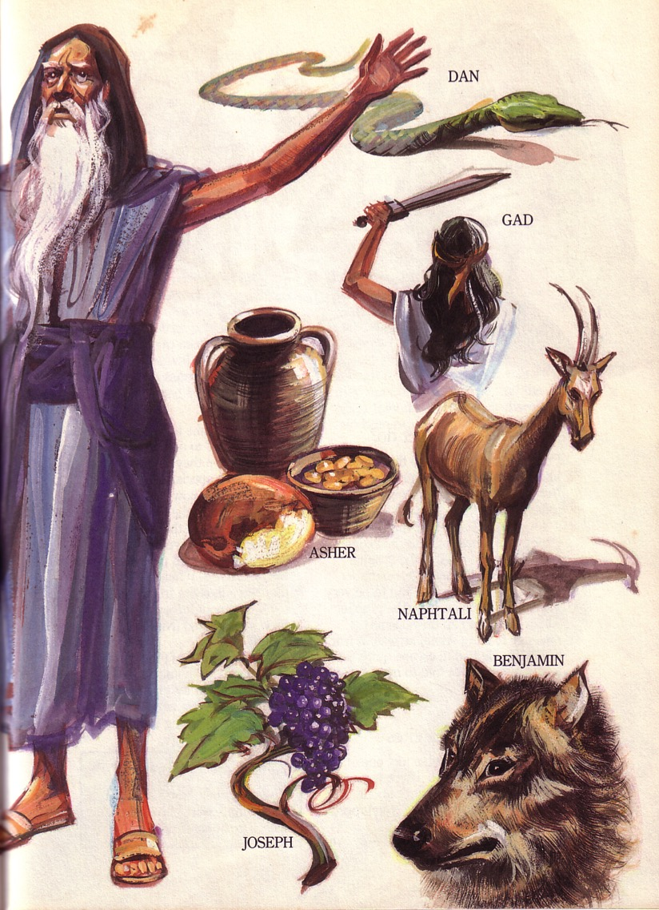
Jacob's Blessing His 12 Sons Was Prophetic
(Gen. 49)

Slide 91
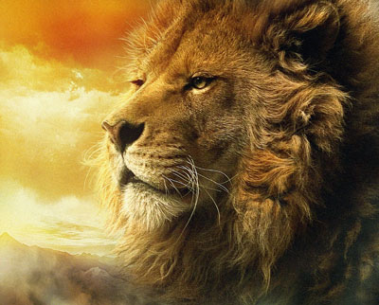
Christ Descended from Judah
"Judah, my son, is a young lion that has finished eating its prey. Like a lion he crouches and lies down; like a lioness—who dares to rouse him?
¹⁰The scepter will not depart from Judah, nor the ruler's staff from his descendants, until the coming of the one to whom it belongs, the one whom all nations will honor" (NLT).
Since Jacob's blessing in Genesis 49:9-10, the lion has depicted a king…

Slide 92

Key Word for Genesis:
56
Election
19
©2003 TBBMI
7.5.03a.
Notes:
Election is seen in the last section of Genesis too—Joseph makes his brothers swear to return his bones to Canaan when the family returns home as a sign of his faith in the promise of God, then he dies (50:22-26).

Slide 93

God promised believers like us blessings of the Abrahamic Covenant.

Slide 94
How can you be faithful to God in a world of idols?
IDOLS
of the
HEART
2 ways

Slide 95

Main Idea of Genesis
Live out God's choice of you and promises for blessing

Slide 96

How should you respond to God's election and promise?

Slide 97
Black

Slide 98


OT Preaching link at BibleStudyDownloads.org
Get this presentation and script for free!

